Slide 1
Evaluating the Impact of Knowledge Graph Context on Entity Disambiguation Models
Yuye Zhu

Slide 2
Contents
Introduction
The approach
Experimental results
Conclusions

Slide 3
Contents
Introduction
The approach
Experimental results
Conclusions

Slide 4
Named Entity Disambiguation (NED)
Entity Linking consists of two subtasks: Named Entity Recognition (detecting mentions) and Named Entity Disambiguation (linking the named entity to a knowledge base).
The short highway in New South Wales and the Australian Capital Territory in Australia, it is part of Sydney-Canberra National Highway link.

Slide 5
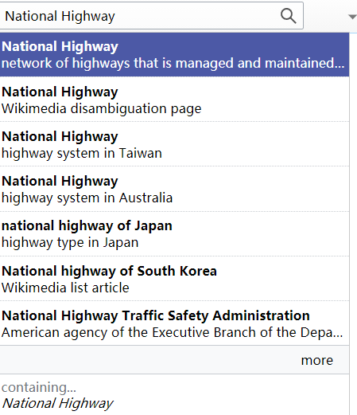

Entity ambiguity
Collaboratively Edited
Do not follow a strict naming convention

Slide 6
Entity ambiguity
The short highway in New South Wales and the Australian Capital Territory in Australia, it is part of Sydney-Canberra National Highway link.

Slide 7
How?
Notes:
因为考虑

Slide 8
How?
Sentence Context
The short highway in New South Wales and the Australian Capital Territory in Australia, it is part of Sydney-Canberra National Highway link.
What else?
Notes:
因为考虑

Slide 9
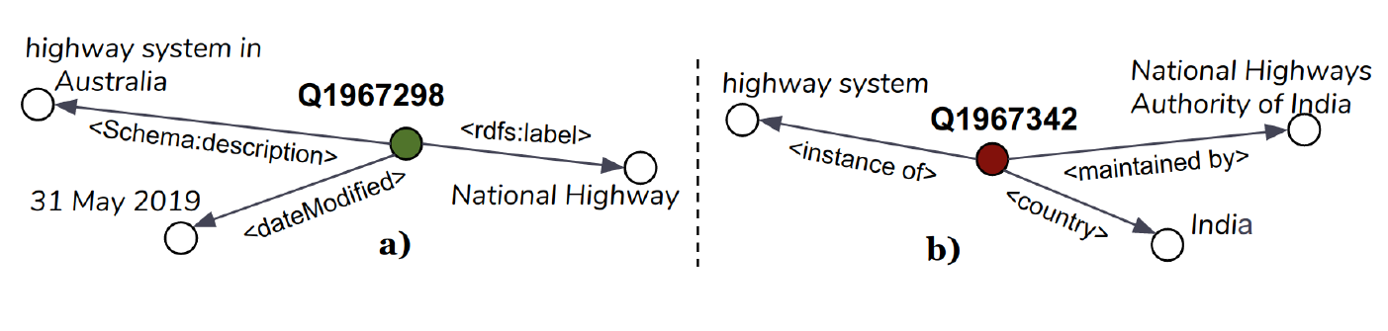
How?
Sentence Context
The short highway in New South Wales and the Australian Capital Territory in Australia, it is part of Sydney-Canberra National Highway link.
Transformer Model
Knowledge Graph Context
Notes:
因为考虑

Slide 10
Three questions
Q1: How does applying KG context impact the performance of transformer models on NED over Wikidata?
Q2: What is the performance of different configurations of KG context as new information signals on the NED task?
Q3: Can we generalize our proposed context in a state of the art NED model for other knowledge bases such as Wikipedia?

Slide 11
Contents
Introduction
The approach
Experimental results
Conclusions

Slide 12
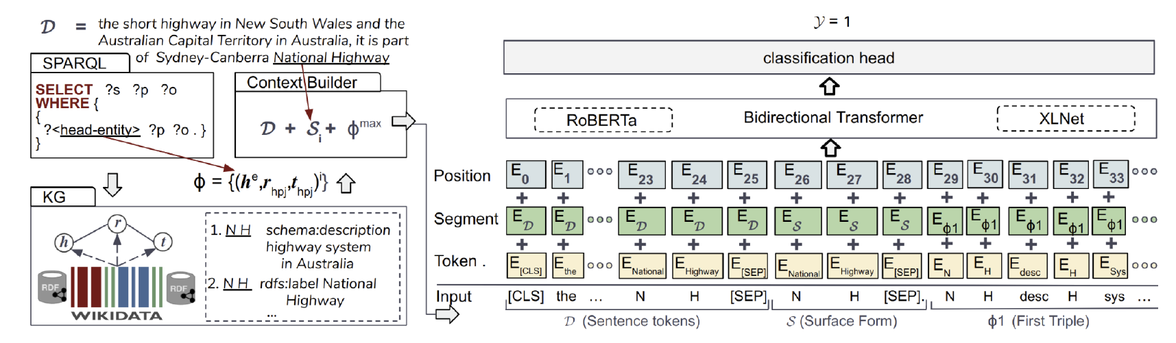
Model Overview

Slide 13
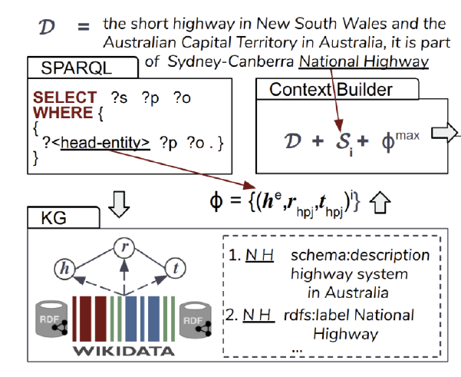

Fetch triples
SPARQL: Query Language
Results: $Φ=\{{(h^{e},r_{hp},t_{hp})}^{i}\}$
$h^{e}$: the entity to be classified
$hp$: hop count (1 or 2)
$i: 1,2,…,1000$

Slide 14
Fetch triples
National Highway description highway system in Australia
National Highway label National Highway

Slide 15
Verbalized into natural language form

Slide 16
Verbalized into natural language form

Slide 17
Contents
Introduction
The approach
Experimental results
Conclusions

Slide 18
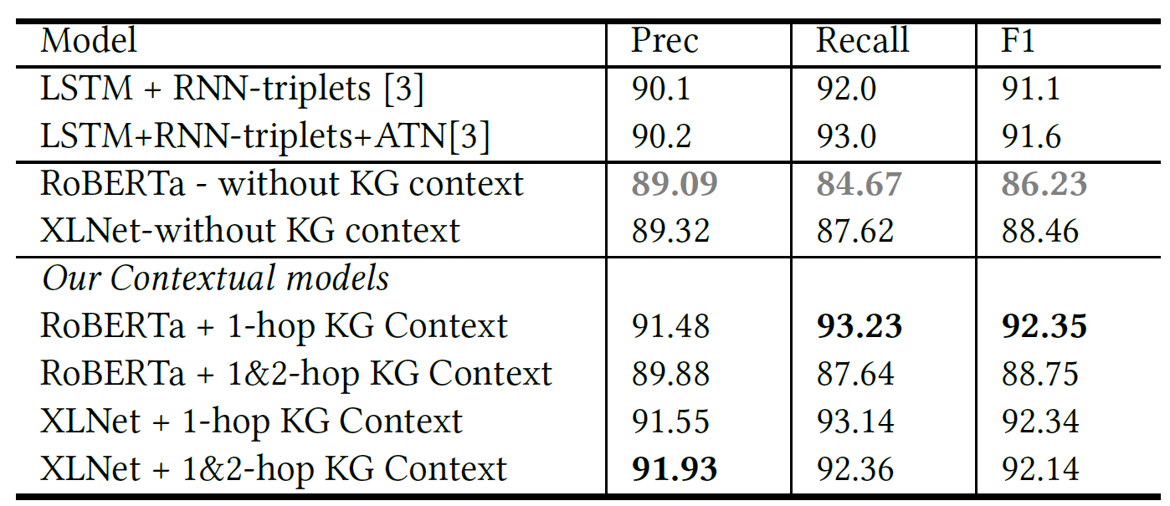
Wikidata-Disamb dataset
Notes:
Based on our results, we postulate that although the Transformer based language models are trained on huge corpus and possess context for the data, they show limited performance even against the RNN model.

Slide 19
Wikidata-Disamb dataset
Notes:
transformer models outperform the baseline models when fed with our proposed KG

Slide 20
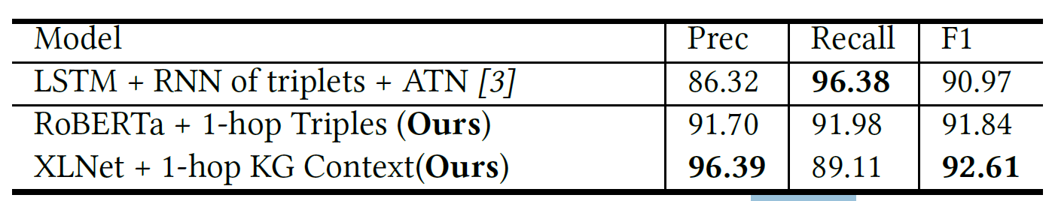
First two questions
Q1: How does applying KG context impact the performance of transformer models on NED over Wikidata?
Q2: What is the performance of different configurations of KG context as new information signals on the NED task?

Slide 21
Wikidata-Disamb dataset
Notes:
including triples from higher hop counts either exhibit an inverse impact on the performance or have minimal effect on overall model behavior
This signals that the further away we drift from the head entity, the noisier the signal provided by the context added
XLNet shows a more stable behavior
Our best performance can then be attributed to the quality of textual context learned by the transformers as well as the optimal choice of KG-triples context.

Slide 22
The third question
Q3: Can we generalize our proposed context in a state of the art NED model for other knowledge bases such as Wikipedia?

Slide 23
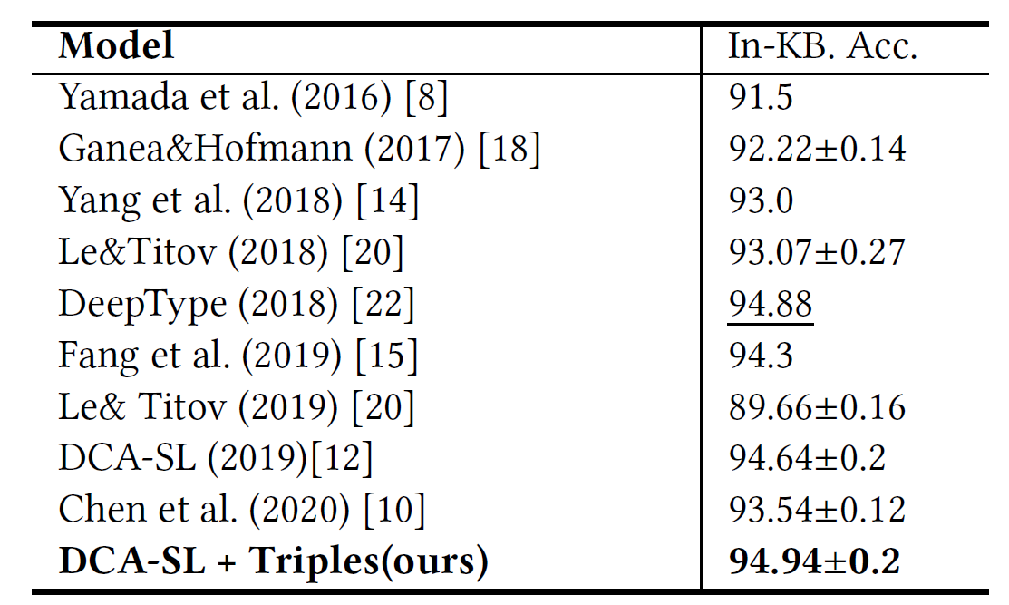
Generalizability Study (AIDA-CONLL)
Notes:
Our proposed change (DCA-SL + Triples) outperforms the baselines for Wikipedia entity disambiguation

Slide 24
Contents
Introduction
The approach
Experimental results
Conclusions

Slide 25
Three questions
Q1: How does applying KG context impact the performance of transformer models on NED over Wikidata?
Q2: What is the performance of different configurations of KG context as new information signals on the NED task?
Q3: Can we generalize our proposed context in a state of the art NED model for other knowledge bases such as Wikipedia?

Slide 26
Q&A

